Slide 1
Practical application of the Five Domains Model for Animal Welfare Assessment
Roly Owers MRCVS
Chief Executive
World Horse Welfare

Slide 2
Outline
World Horse Welfare
What we do
Applying the 5 domains as an equine welfare assessment tool – the Animal Centric approach
Practical application and why it isn’t a one size fits all process
What you can do now

Slide 3
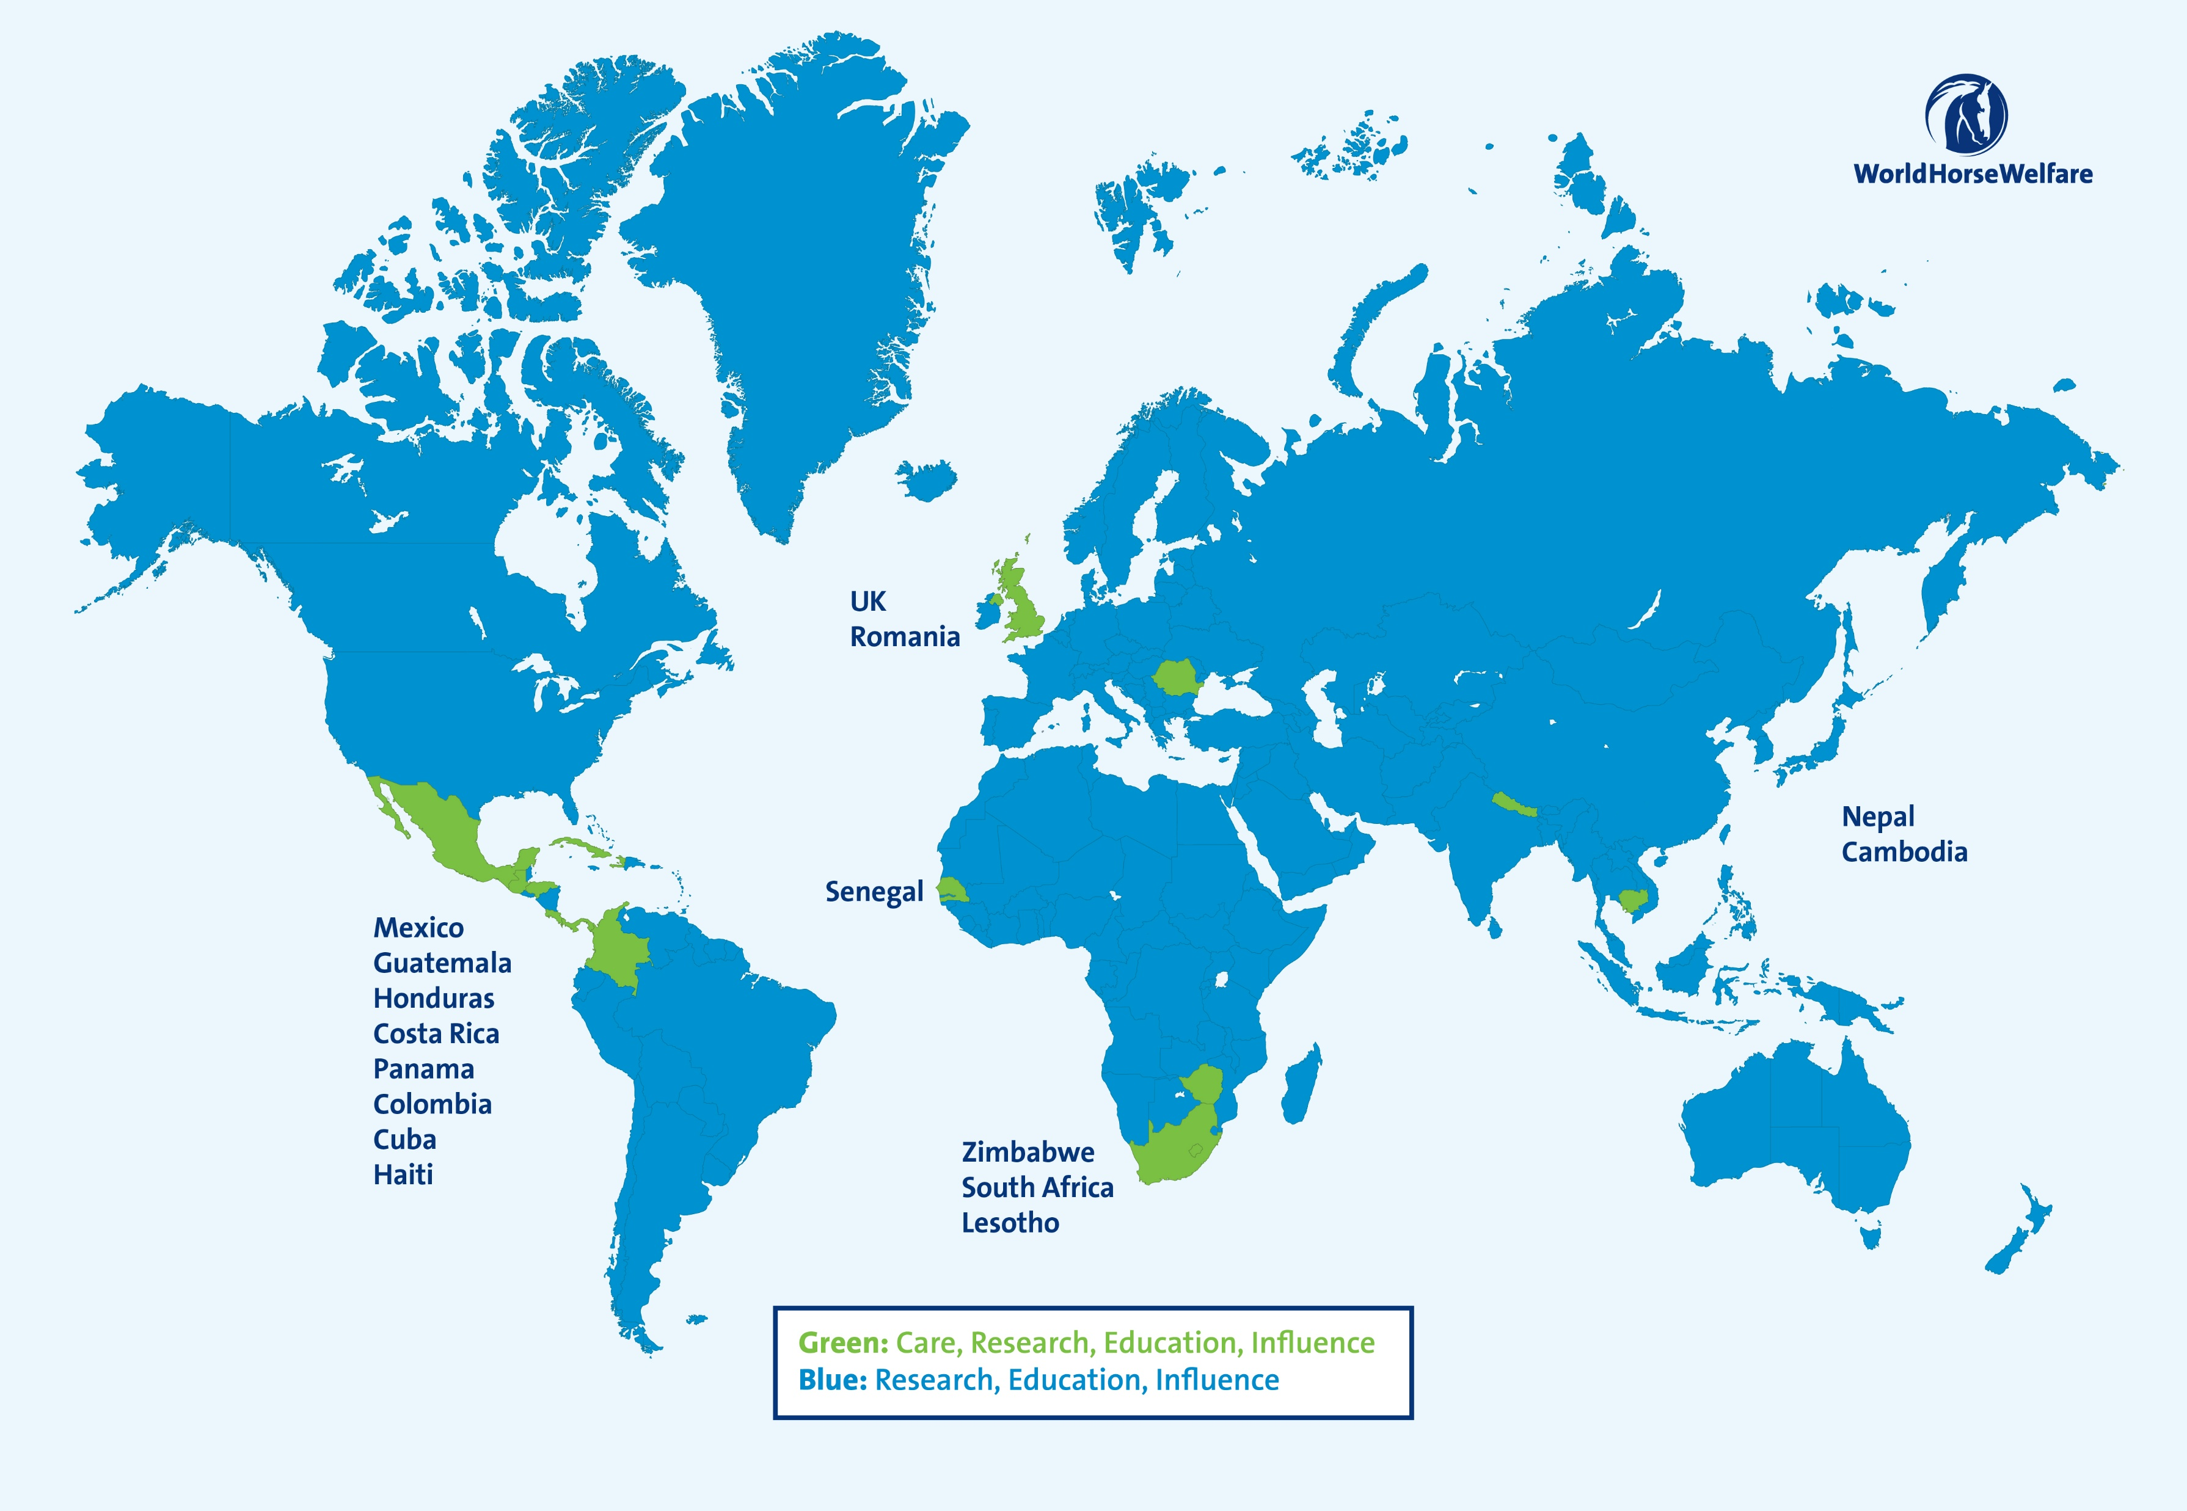
World Horse Welfare
Leading equine charity since 1927
Inspire people to put the horse at the centre of how we think, act, ride and care for them
Work in partnership with governments, universities, regulators, other NGOs
Strong veterinary credentials
Notes:
Founded in 1927 – at our heart is a caring but pragmatic approach to equine welfare​
​
We inspire people to put the horse at the centre of how we think, act, ride and care for them
​
Central to our approach is working in partnership – with horse owners, communities, governments, sport regulators and other NGOs
We have strong veterinary credentials

Slide 4
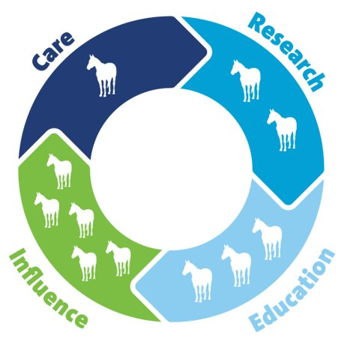

World Horse Welfare – what we do
Notes:
We improve the lives of horses through Care, Research, Education, Influence​
​
•All of our activities are related:
•Care: We provide direct care for equids in the UK and internationally which allows us to support -
•Research: Using our experience, we support and use research to uncover the root causes of the welfare problems we see and their solutions. This evidence builds our knowledge and enables our work in -
•Education, which we provide to horse owners in multiple formats to numerous audiences. All of this brings us the credibility to -
•Influence, enabling us to shape attitudes, policies and practices to sustainably improve welfare for millions of horses – in the UK and around the world

Slide 5
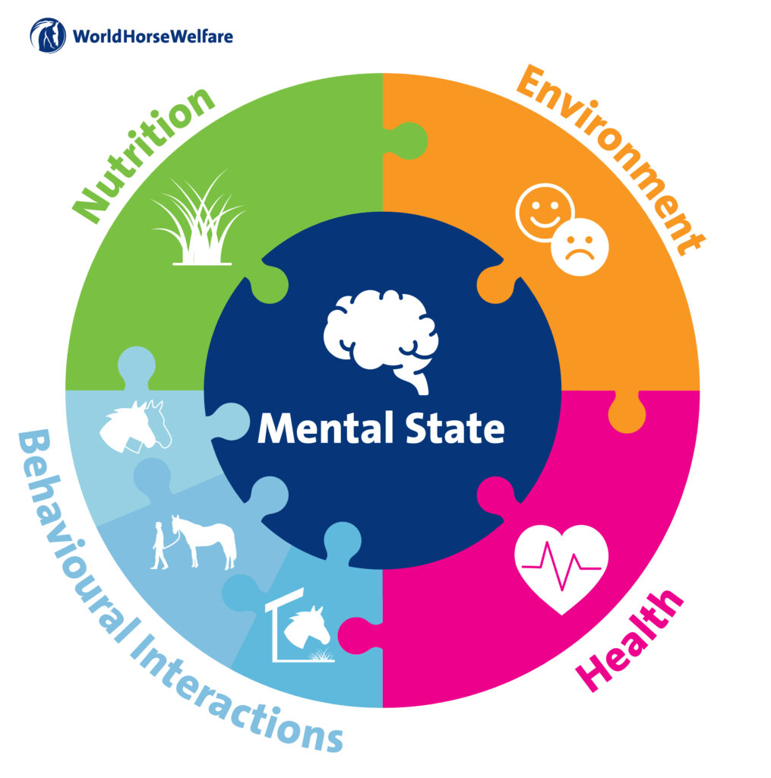
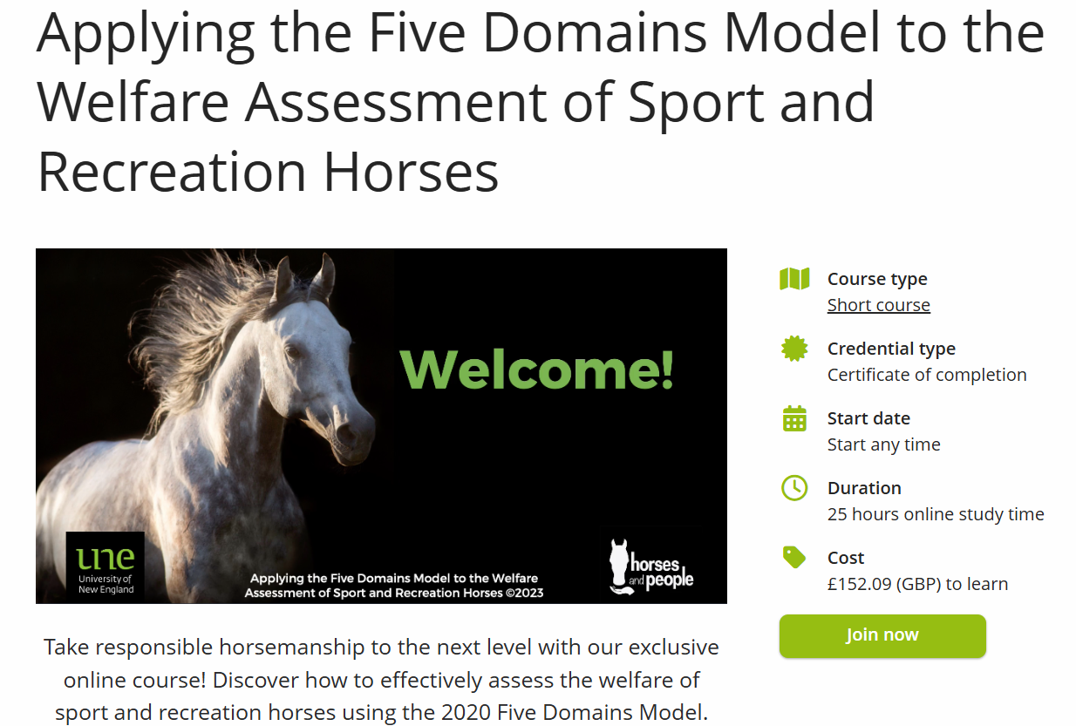
Notes:
The five domains model of welfare assessment has become a key feature in many organisations welfare policies
The Five Domains replaces the Five Freedoms, which you may have heard of and the Animal Welfare Act is based on.
But the Five Domains is more holistic and sophisticated, and is a better prism through which to consider welfare, not least because it:
Highlights that the mental welfare of an animal is fundamentally important to their overall welfare – in fact the four other domains all feed into the 5th domain, mental state.
Expands behavioural interactions – which includes their interactions with their environment, with other horses and with other animals (including people) - that have a strong bearing on their welfare
But how can we turn theory into practice to understand what level of welfare we are providing?
Cristina Wilkins, who has been integral to the development and dissemination of this model in the equine sector, runs a course through the University of New England which teaches participants how to assess the welfare of sports and recreation horses using the model at an individual level.
For owners with one or two horses, this is a doable task. When we need to consider multiple horses and what this means for a whole yard, how we can do this practically was a key question industry was asking and one we have attempted to answer.

Slide 6
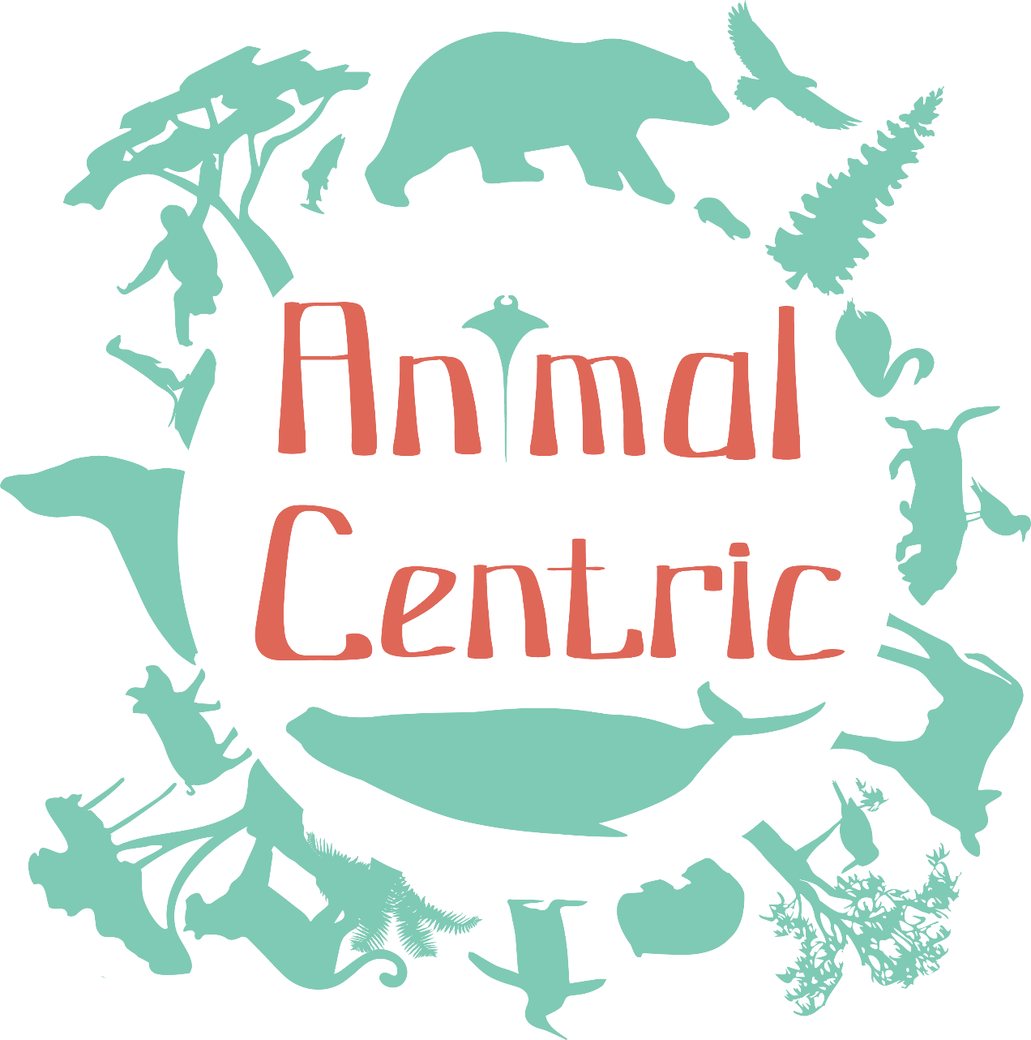
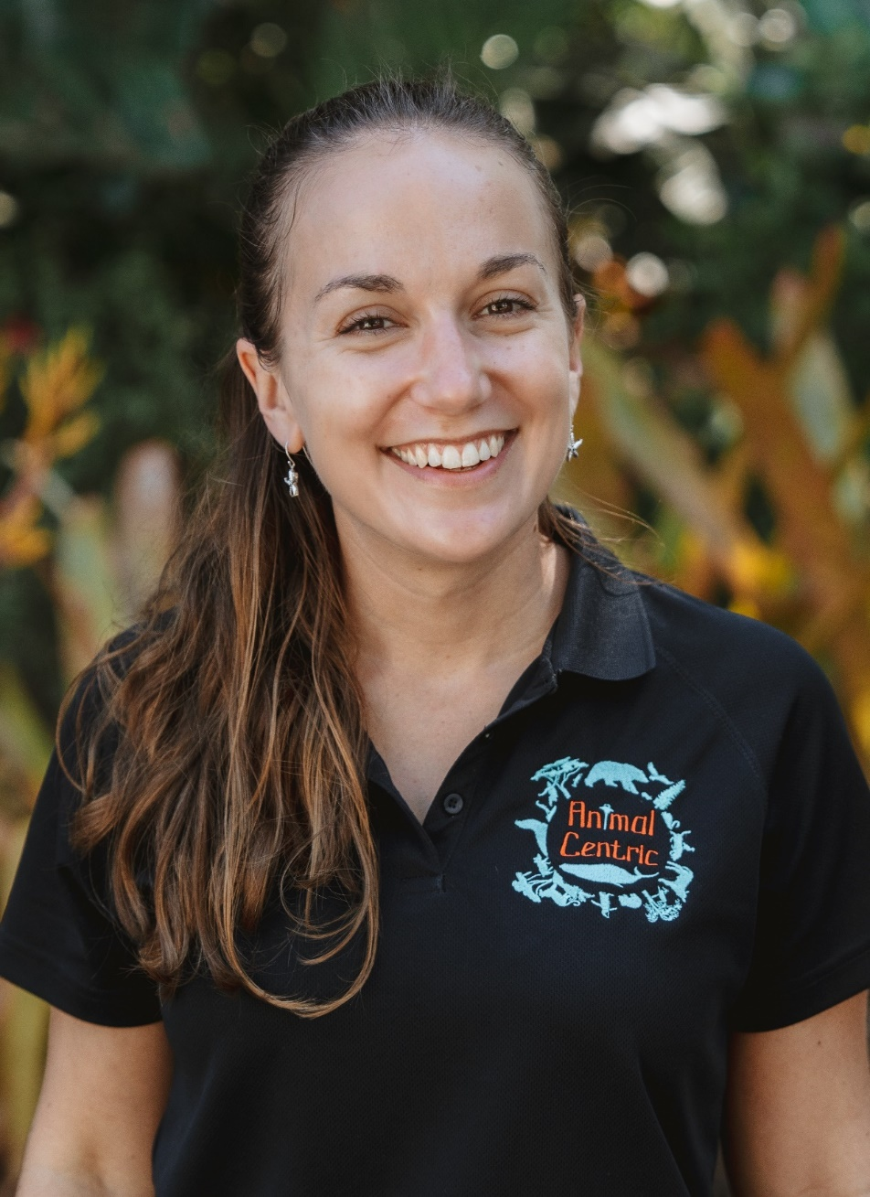
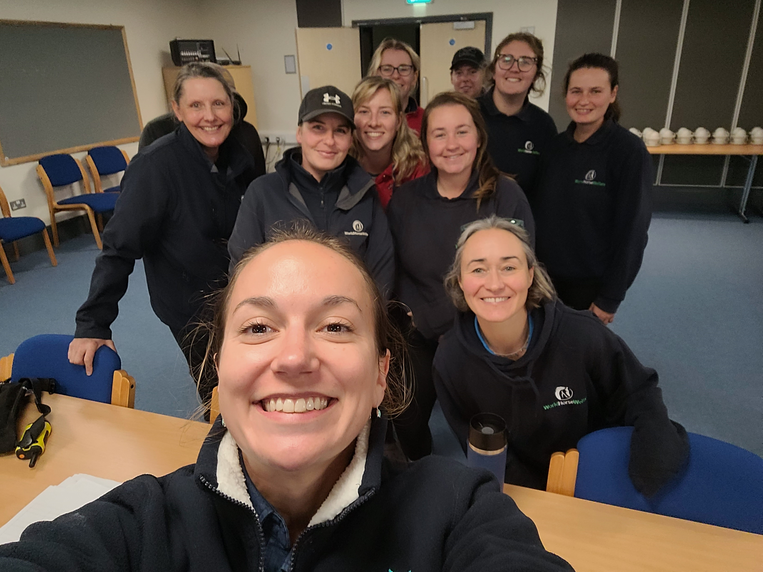

Five Domains Project
A multi-year collaboration
Jill Fernandes, PhD
Animal welfare scientist & consultant
in Brisbane, Australia
World Horse Welfare
Glenda Spooner Farm
(first trial farm of four)
Notes:
Cristina introduced us to Jill Fernandes, an independent animal welfare consultant who founded and runs her own consultancy business, Animal Centric. Jill has previously worked with zoos and aquariums across Australia embedding the 5 domains model into their animal welfare assessment protocols and wider practice.
We thought it would be a great idea to get someone independent, from outside the horse world, to help us really challenge ourselves in assessing the welfare of horses that we provide through the Five Domains model.
Jill first came over in October 2024, to our Glenda Spooner Farm in Somerset, to help us devise a horse focused, yard-based assessment tool and the next few slides will detail the process we went through.

Slide 7
Five Domains Project
Goals:
1.
Develop a tool based on the Five Domains Model that can be used to assess the welfare of large groups of horses living in yards, for use on our farms
Welfare Assessment for Horses in Yards (WAHY)
2.
Tailor the welfare assessment tool to the welfare concerns, considerations, and priorities identified by the staff at each of the four farms (e.g. Glenda Spooner Farm placed a greater emphasis on clicker training)
3.
Engage staff at each farm about the Five Domains Model and how to assess welfare objectively using animal-based measures. Then facilitate the WAHY at each farm in group sessions (lasting 6-10 hours on average, split across multiple days).
4.
For each farm, generate a list of WAHY Actions that are proposed by staff and prioritised by welfare score, and support each farm in implementing these Actions, little by little. Then work with each farm how to monitor welfare evidence (e.g. physical, behavioural) from the horses on an ongoing basis to know if welfare has improved.
5.
Share this welfare assessment process with the broader equine community.
Notes:
Our key collaborative goals were to:
Develop the welfare assessment tool – which we are referring to as the WAHY – Welfare Assessment for Horses in Yards
Produce an assessment tool that worked for us as an organisation but could also be rolled out to wider industry
Engage key staff from grooms to groundsmen in the process and establish a level playing field in terms of everyone’s understanding of the five domains model. Staff then took that knowledge forward to score the welfare criteria we had previously identified thinking for each of examples had a negative experience and consider what we could do to prevent that for horses in future.
The outcome of the scoring process was a monumental actions list, prioritised by score for the farm team to then delegate between staff members - and management! - in line with wider strategic planning and budgets.
When completing actions, a key element of this is to get feedback from the horses – using behavioural observations to determine reliable animal-based measures to assess whether the intervention has had the desired effect and the experience of the horses has improved.
Finally, this is not a process we are gatekeeping – we were the guinea pigs, particularly the team at GSF – but we would like as many organisations as possible to undertake the process because we found it so useful.

Slide 8
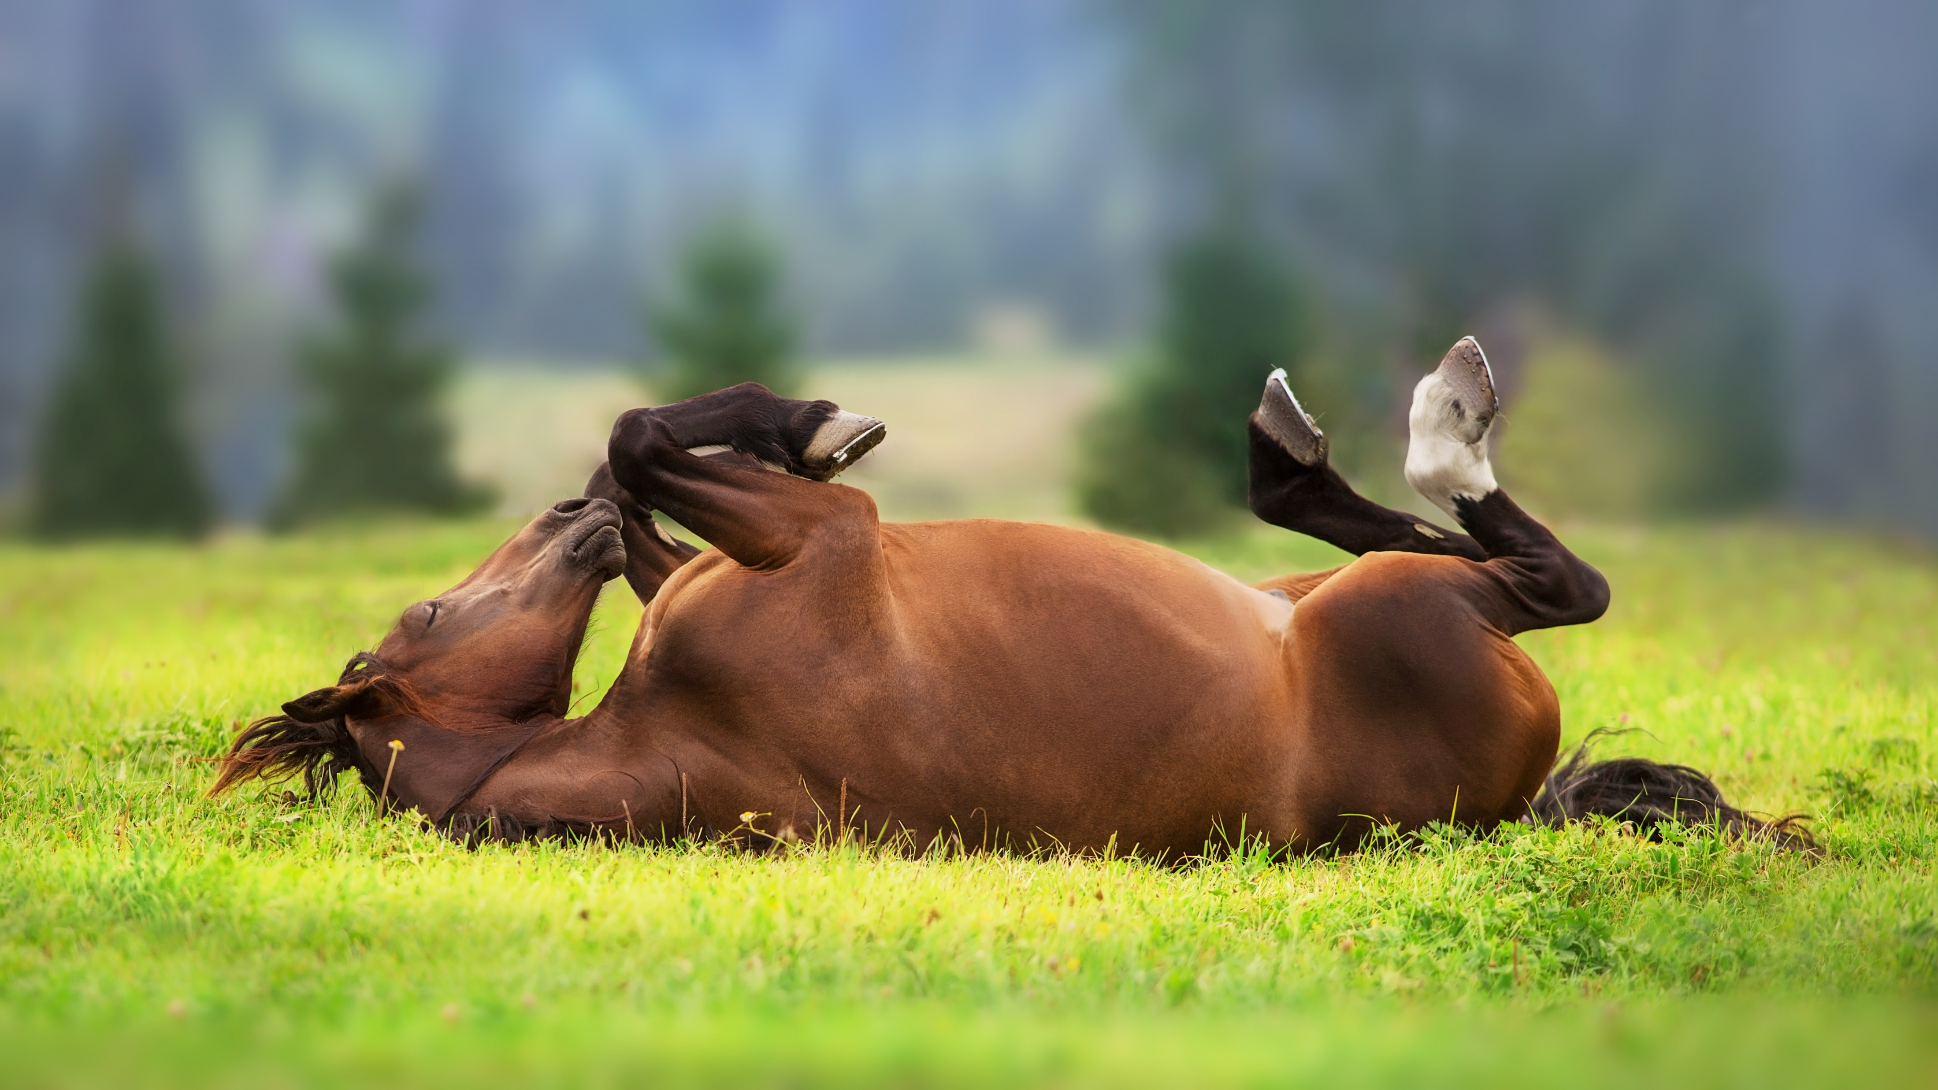



Animal Centric’s Participatory Process
Leadership
Horses determine
best practices
Community
Sharing experience +
publicly available mini-WAHY
Ask the Animal
Staff empowerment
as animal welfare specialists
Choice & motivation trials by farm staff
Evidence-based welfare decisions
Evidence-based decisions
WAHY Actions + animal-based measures that can
be monitored by farm staff year round
Objective welfare assessment
Welfare Assessment for Horses in Yards (WAHY) by farm staff
Staff knowledge
Understanding of farm staff knowledge, attitudes, and practices
Staff buy-in
Horse Welfare Horizon plans for each farm, based on interviews with farm staff
Notes:
The steps on the slide outline Jill’s overall approach and clearly shows how the horses’ experience is at the centre of it.
The green ticked boxes are what the team at GSF have already achieved and the orange boxes that are ticked are in progress, and the empty orange boxes are in the planning stages.
The ones that we have not yet started will develop as we gather more more and more horse-based evidence on the outcomes of our interventions and further embed new ways of working into our practice, not just at GSF but across the whole organisation.
The aim is to use the data gathered to change the narrative from 'we think horses need...' To 'the horses are telling us they need', and that will take time.
The process hinges on the involvement and buy in from those working day to day with the horses in our care.
Their knowledge of individual horses and what they may be experiencing form the basis of the wider assessment process.

Slide 9
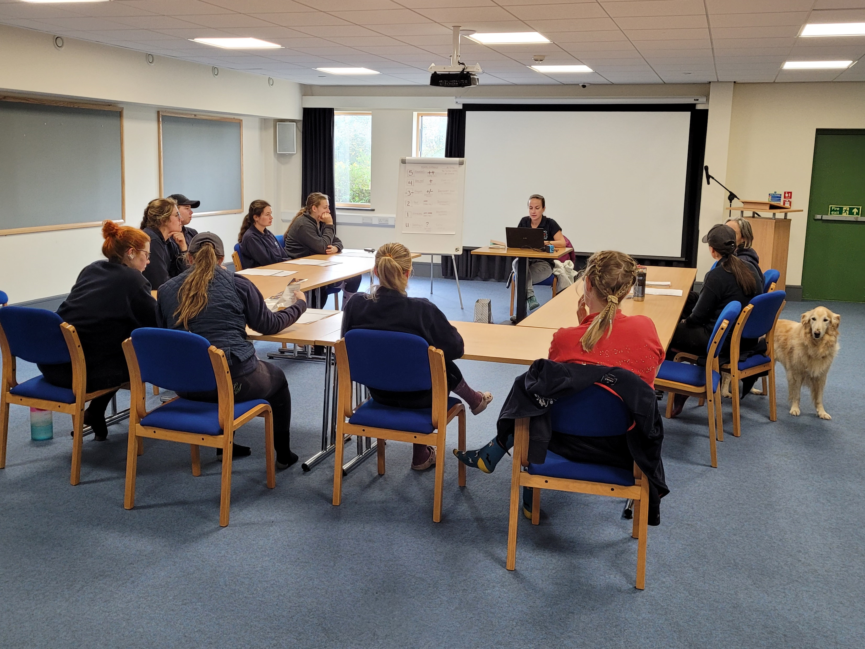
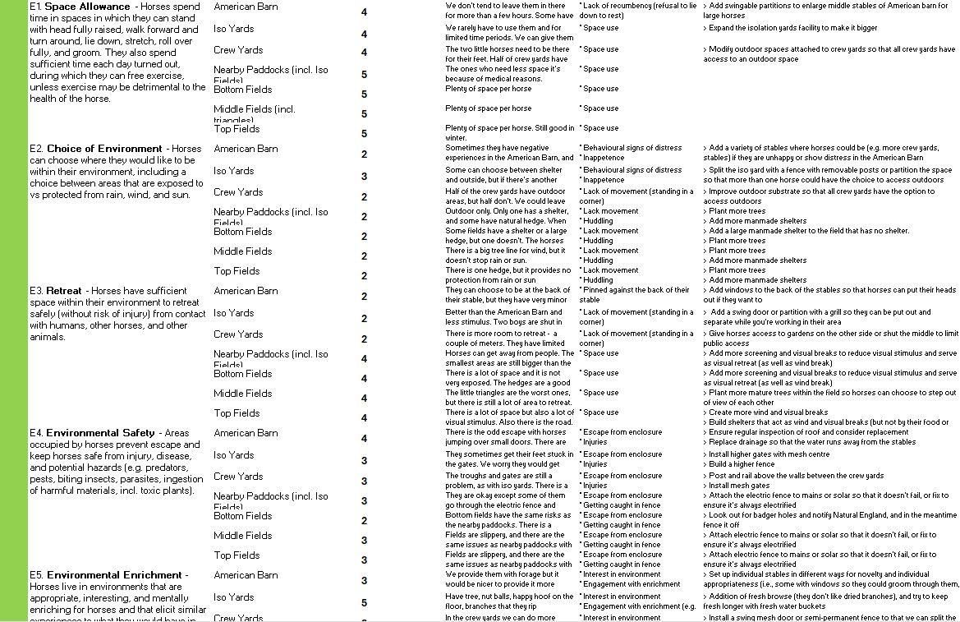
Five Domains Project
Glenda Spooner Farm, October 2024
Welfare Assessment for Horses in Yards (WAHY) : 40 criteria, ~10 hours
Notes:
You can see here that it really was a team effort, especially Amber, Claire’s dog who was chief morale officer for many of the workshops!
You can also see just how much data was collected throughout the scoring workshops – over 40 welfare criteria split across the 5 domains were identified, and for many there were further divisions based on how long horses had been on the yard or which part of the yard was being examined such as fields, crew barns, the American barn or isolation unit.
The criteria covered everything from provision of a suitable diet, to degree of choice horses have in their environment and as we take in stallions, even the influence of restricting sexual behaviours. The criteria reflect the diverse requirements of horses as a species and really challenged us in some areas to critically evaluate whether what we are doing is enough.
In terms of the scoring, it could range from ‘unknown’ if there was not enough evidence to be able to reliably give a score, then was numbered 1-5, with 1 being poor and immediate changes to improve horses’ mental state required, to 5 – which was excellent and no further actions could improve horses’ mental state.
Staff deliberated and agreed a score for each criteria with the factors and behavioural indicators that underpin the score
The scores are deliberately scaled low as they are based on the horse who would have had the worst experience - as the focus is on learning how we can improve to cater for every individual horse's experience.
We scored high in so many areas – and could have scored higher had we taken a different approach – but the whole purpose was to be really critical and see where we could do even better.
All ideas for suitable actions were recorded, where action was necessary.

Slide 10
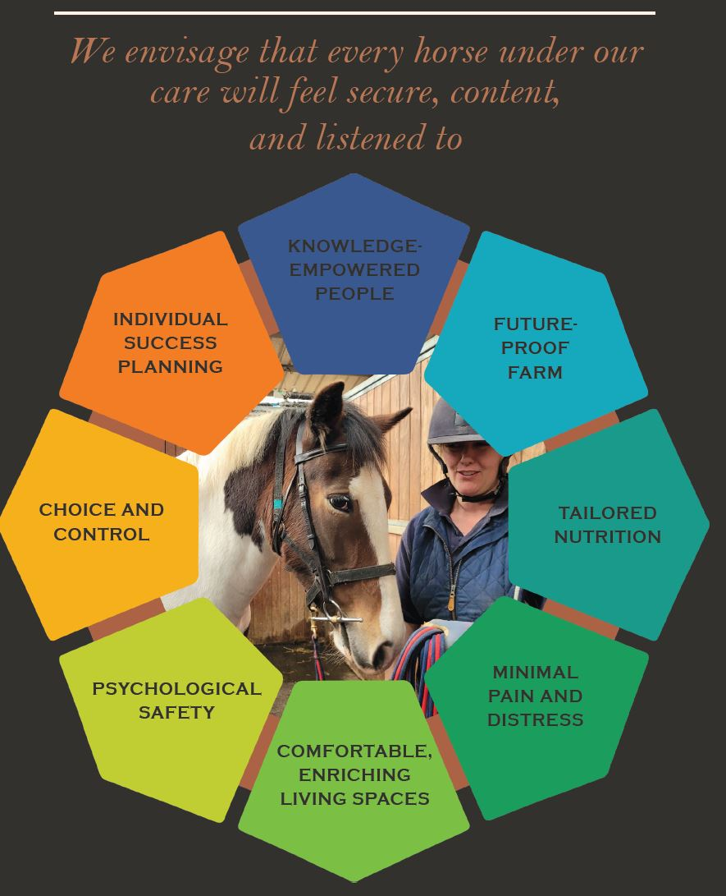
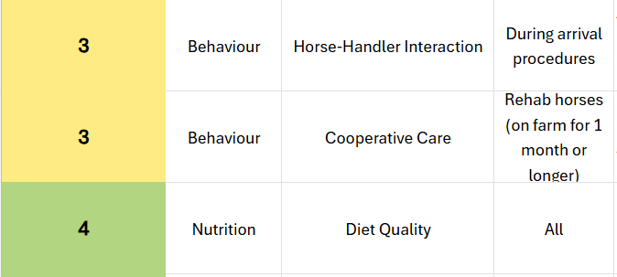
Five Domains Project
325 WAHY Actions generated by Glenda Spooner Farm staff, prioritised by welfare score
Glenda Spooner Farm’s 10-year plan for horse welfare with clear outputs, developed from staff interviews
Notes:
When we say a monumental number of actions were recorded, we mean it. For GSF, 325 actions were identified.
What’s important to note is that some were minor and easily implementable e.g. collecting more browse for horses that are stabled or in the crew barns, whereas others required much more planning and resource behind them e.g., resurfacing gateway entrances, planting trees and hedges or removing partitions from stables.
And scores spanned the whole spectrum which allowed us to really reflect on what we are already doing so well, and where it was clear we needed to rethink our approach.
It's important not to be disheartened if there are lower scores, remember these are based on individual horses that had the worst experience and may not truly reflect the experience of many of the horses. But we have to ask ourselves why? Why did that individual struggle in that scenario?
A subsequent output from this process is a 10-year plan, or welfare horizon document, which is based on the feedback from staff at the very beginning of the process in the staff interviews.
This document highlights the key, overarching themes that the staff at GSF would like to embed over the next 10 years. It also acts as a guide, in conjunction with the actions to help strategically implement changes sustainably and holistically.

Slide 11
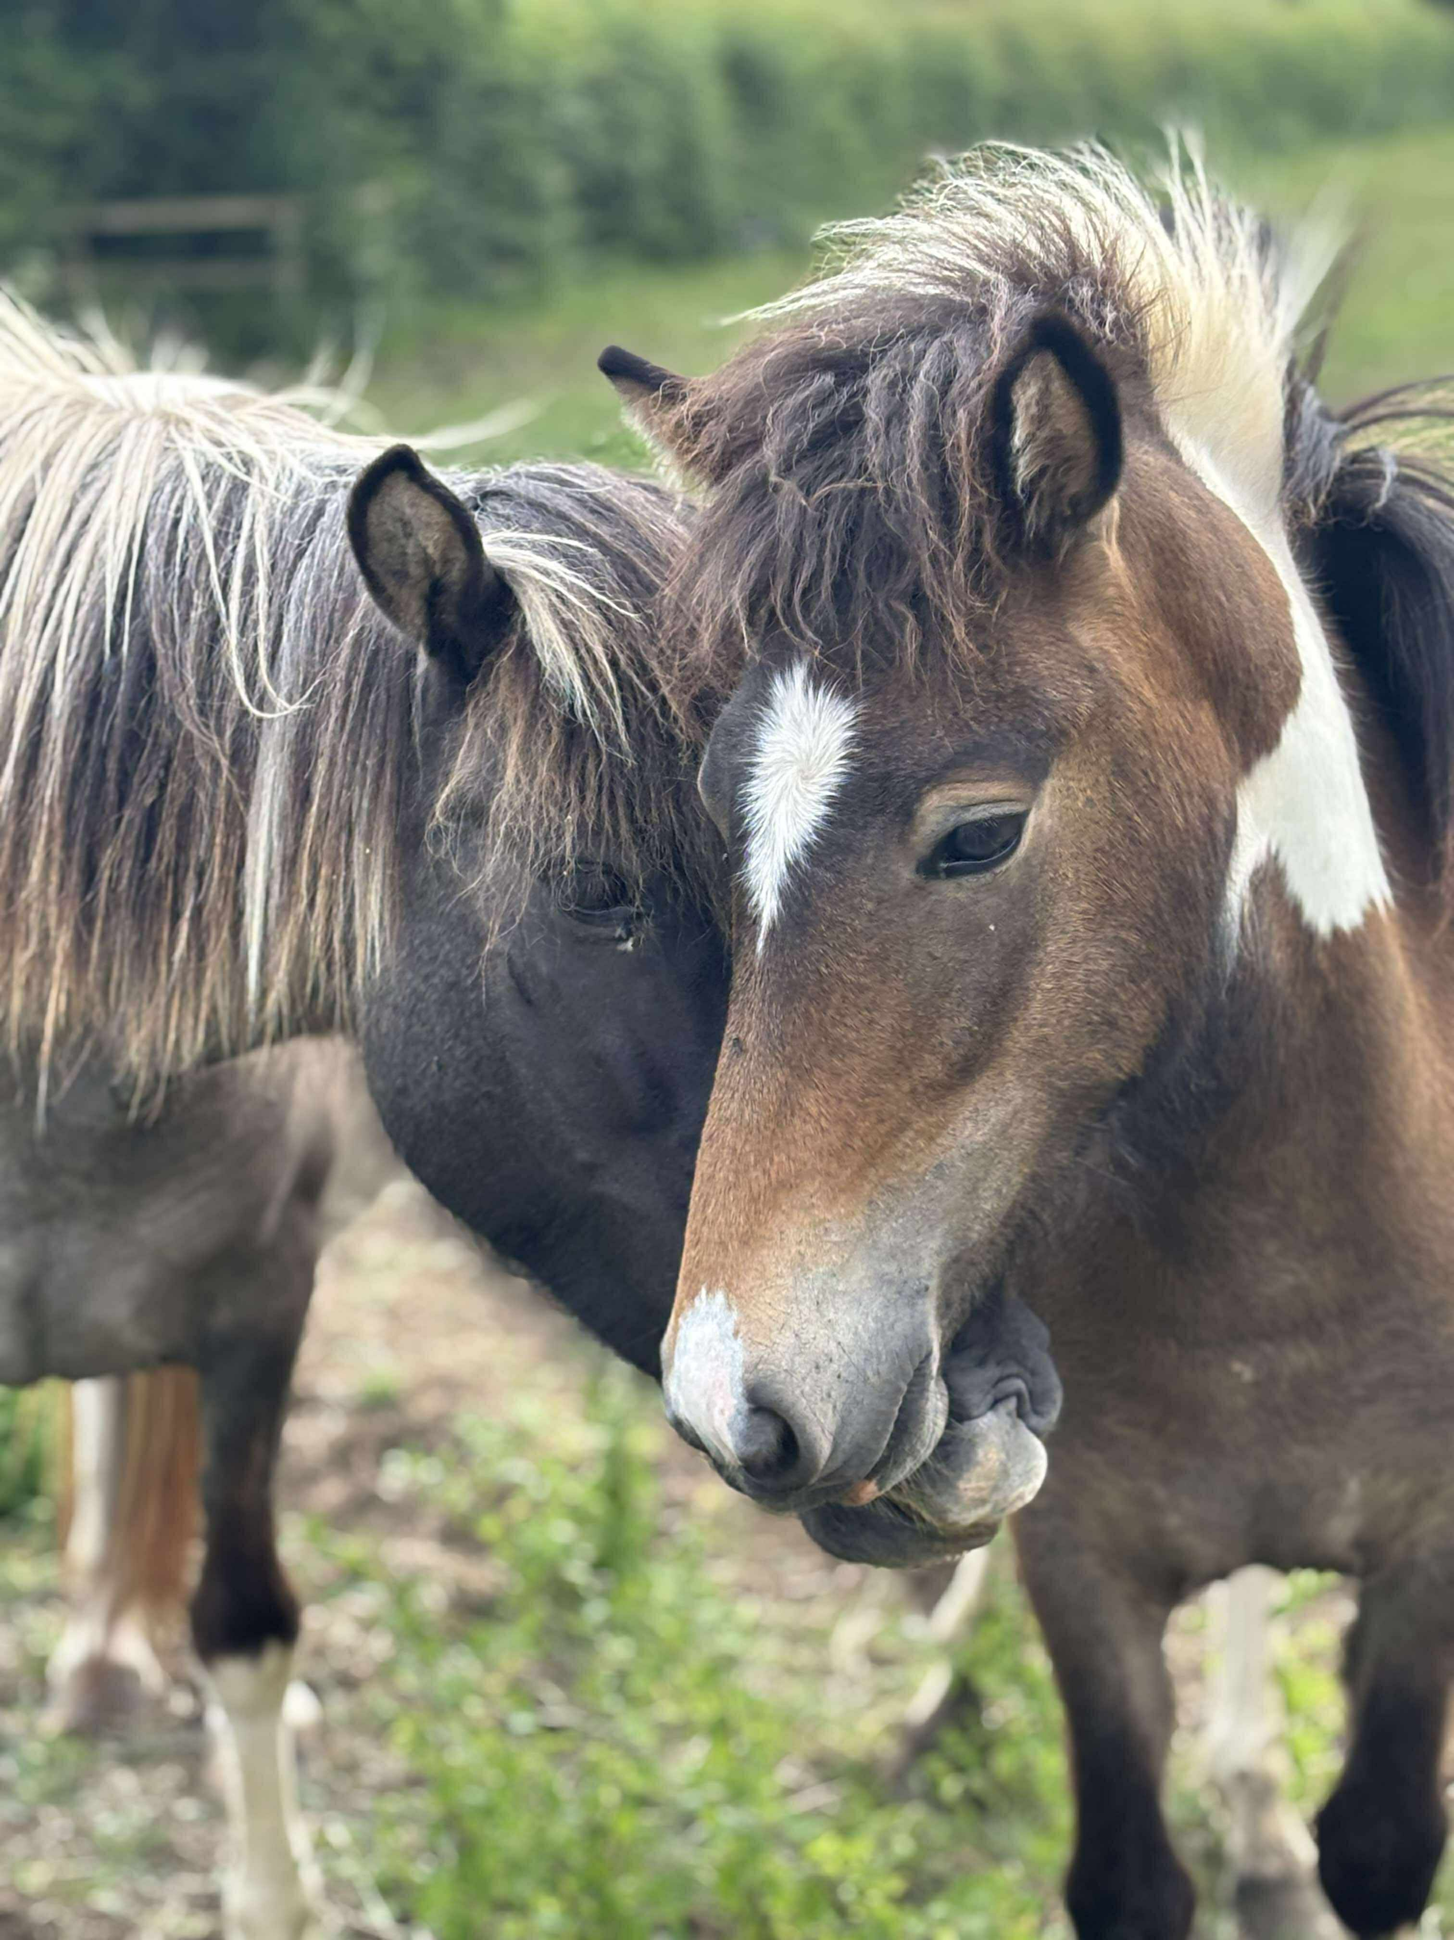
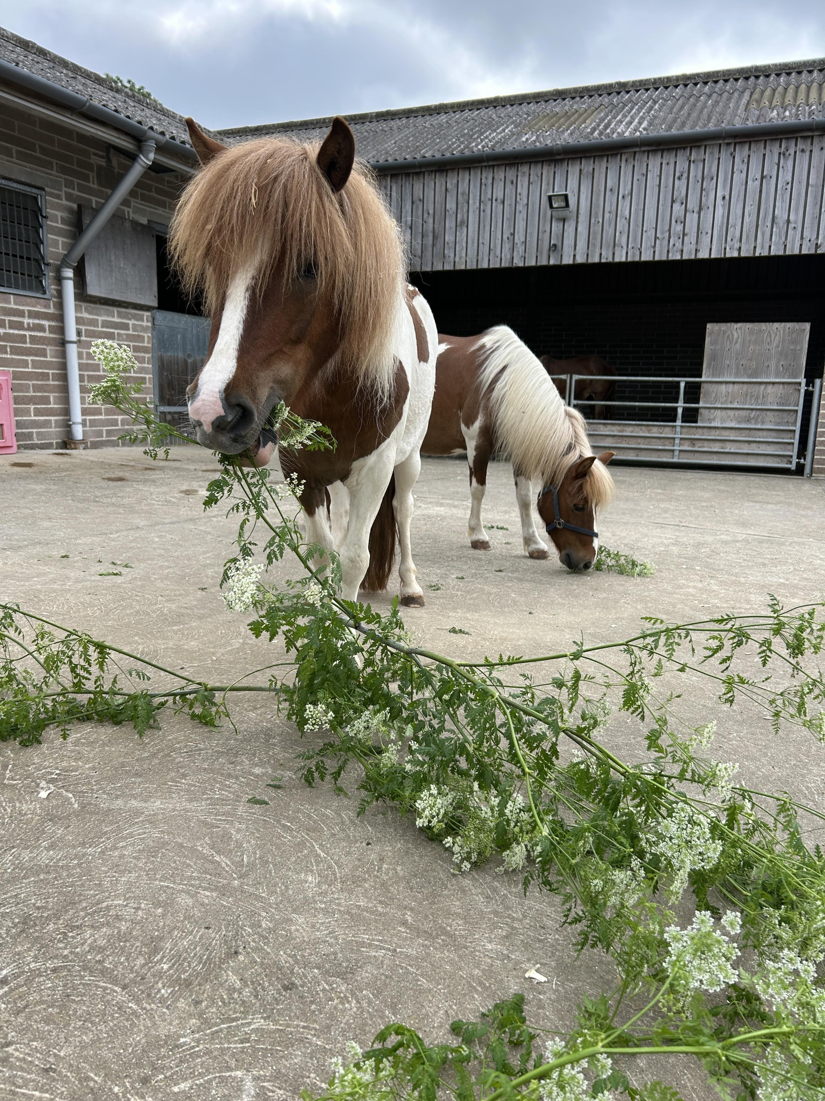
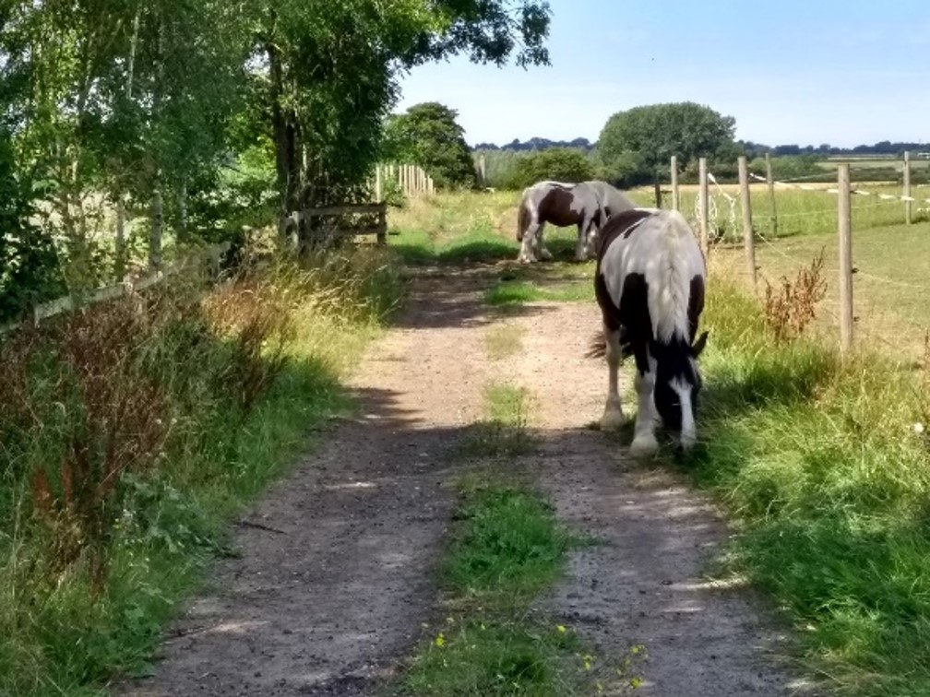
What does that mean in practice?
Teamwork
Creativity
Our interactions
Recording
Horse-led
Budgets and resourcing
Behavioural observations
Reflection
Celebrate strengths
Notes:
What does this mean in practice both for the team and the horses in our care?
Teamwork: staff work together to score, decide actions and implement them. Increases communication between team members and for those that would like more responsibility, it offers them that opportunity. It also puts everyone on the same page.
Budgets and resourcing: the outputs can inform wider planning, budgets and resourcing and can open a dialogue with the team about what can be done immediately and what may need to wait for further funding, helping set expectations about how soon some actions can be delivered as well as what may not be feasible at all. If anyone does know where that elusive magic money tree is, please do let us know!
Creativity: the workshops and scoring sessions are a great source of ideas and it’s important to foster any and all ideas no matter how small or sometimes how impractical they may seem for example, one possible action for stopping water troughs from freezing at GSF was to add large rubber ducks to all them all!
Behavioural observations: the team sessions allowed us to identify what behaviours the team can easily identify and where there may be room for CPD or further development. Observation is such a key part of this process, horses’ experiences are so subjective so it’s important to be able to pick up on slight behavioural nuances that indicate preferences and when horses may be having a negative experience.
Our interactions: The process allows us to consider the horse-human relationship and the influences of our handling, training and all interactions with them which is such a vital part of not only the five domains model, but also of providing horses with some sense of agency over their own lives. We are so often the controlling factor, so how can we make our interactions more of a conversation?
Reflection: A key part of this process is reflection and setting regular catch ups with the team and also with Jill allows us to critically appraise the work we’ve been doing and how the actions are influencing the horses in our care.
Recording: from behavioural observations to budget planning documents, the process allows us to document and record the steps and progress of the interventions in the run up to re-assessing all the criteria.
Celebrating strengths: It’s very easy to focus on the lower scoring criteria and panic – however, the majority of criteria scored well and sometimes excellent. It’s important to remember that and celebrate where we are already doing everything we possibly can to ensure horses are having positive experiences whilst at our farms.
Finally, the process needs to be horse-led – it’s not about what makes our lives easier, it’s about what improves the experiences of the horses in our care.

Slide 12
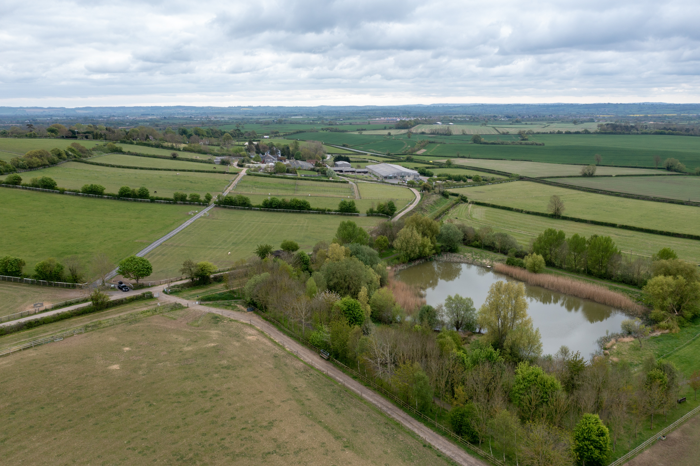
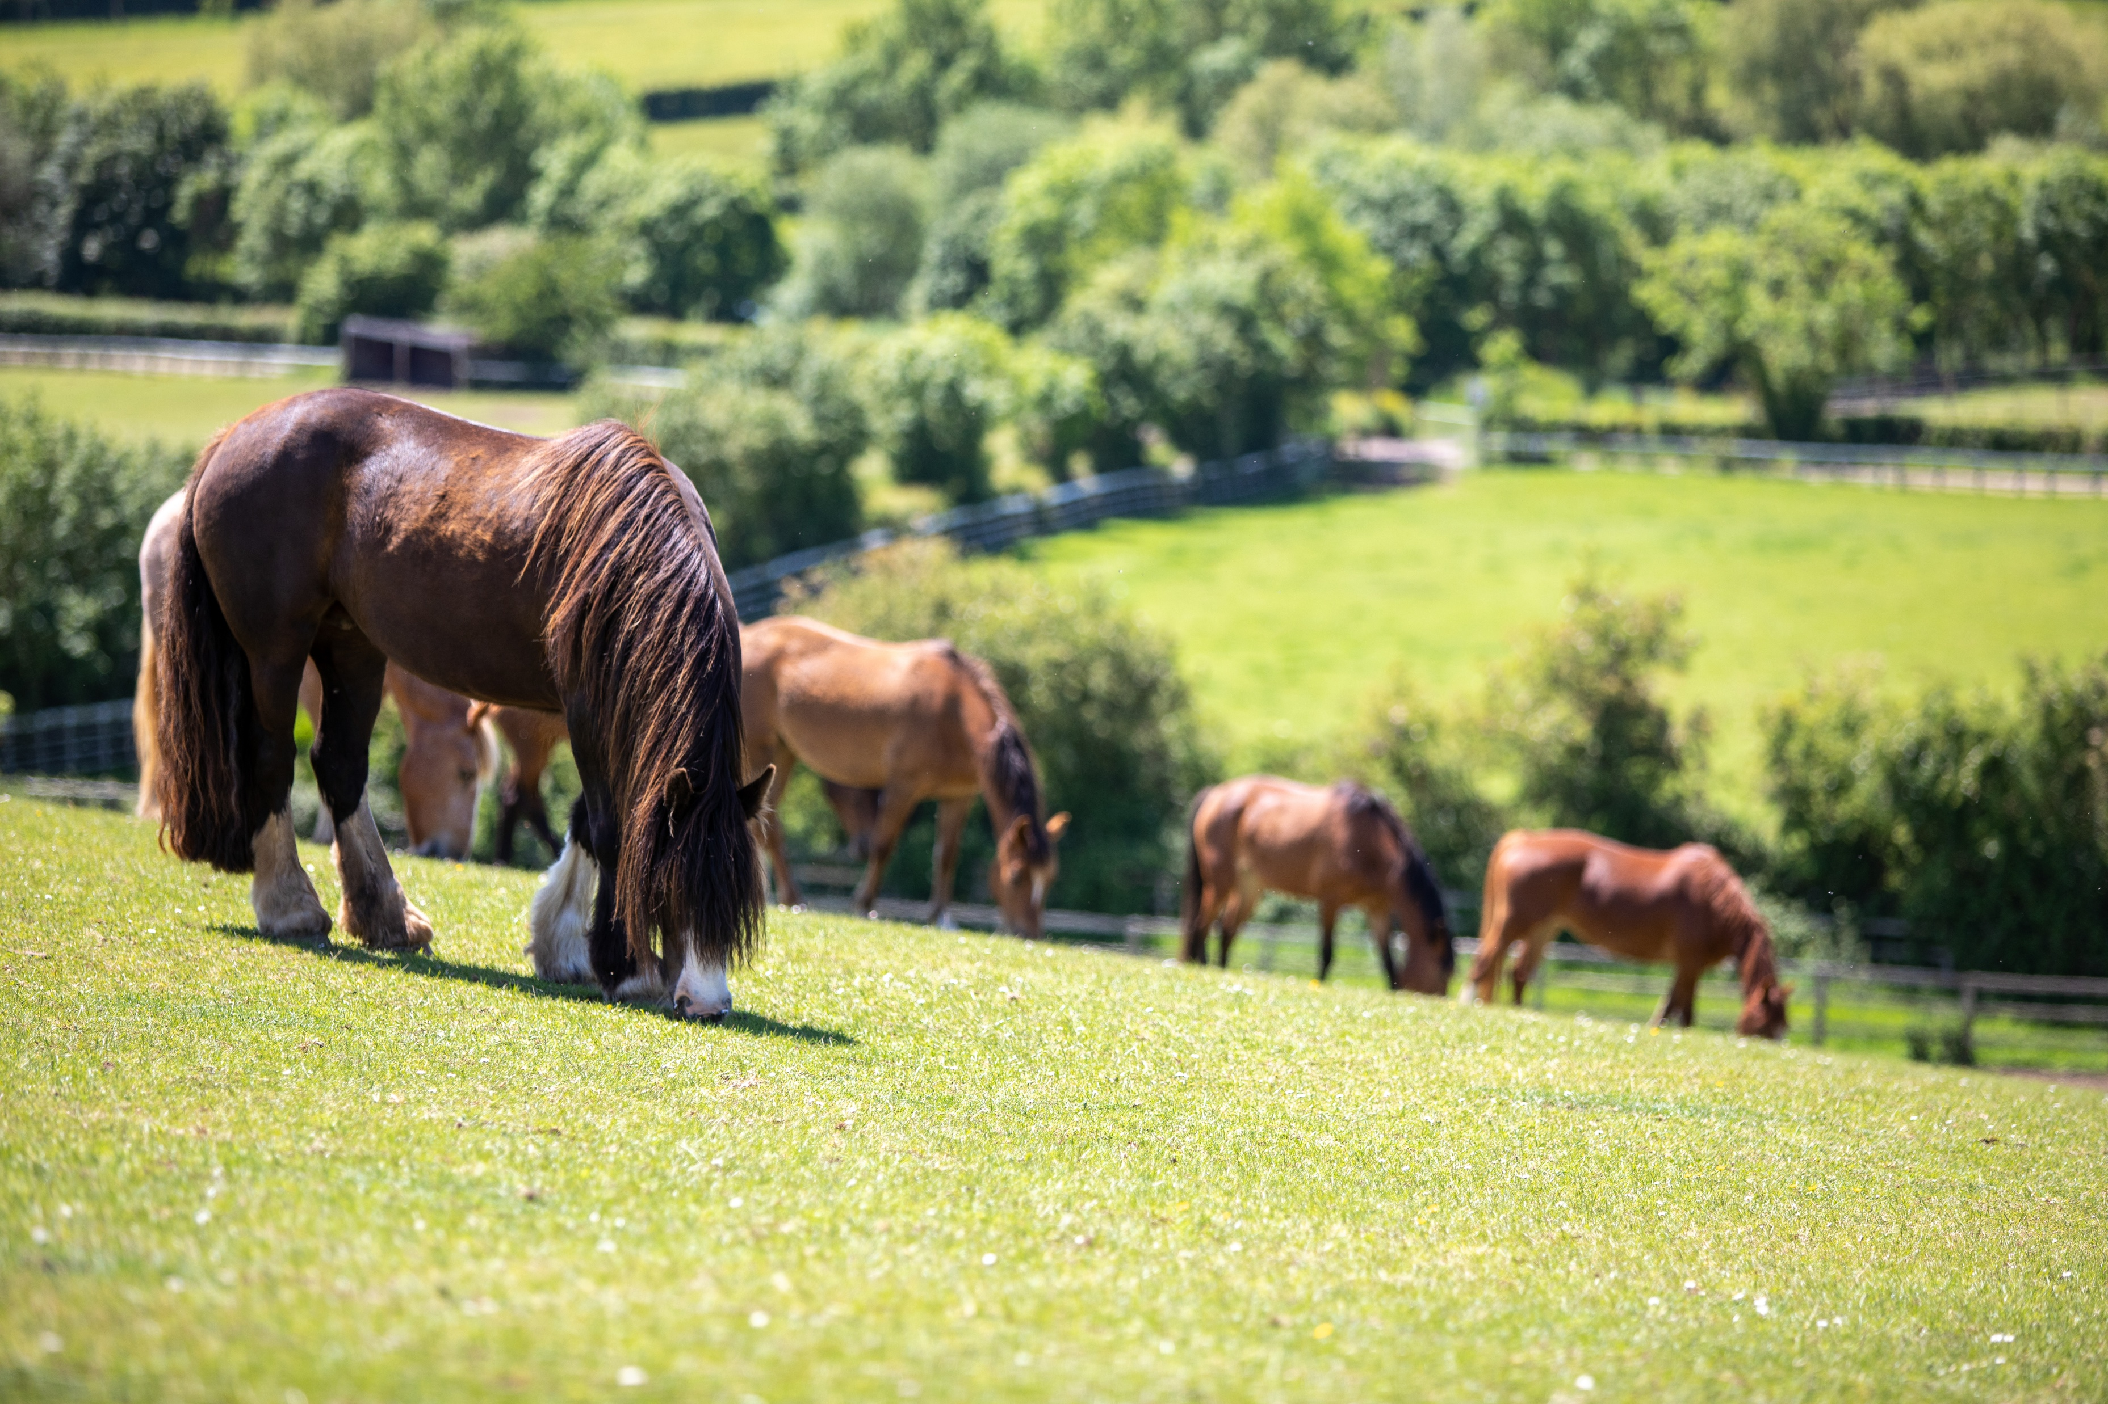
Why the outcomes aren’t ‘one size fits all’
Different facilities and environments
Different staff – different motivations, knowledge, skills and values
Different finances and resourcing
Different horses with different individual needs and experiences
Notes:
We were asked to consider ‘what’s transferable’ for this presentation, and as much as there will be elements that are similar across organisations and establishments, there is also inevitably going to be a huge amount of variation.
From the facilities and environments on offer, to the staff, to financing and resourcing and most importantly the horses at each yard or establishment and what’s important to them, there will be variation – no two yards, and no two horses are the same.
What’s truly transferable is the process we have worked through to get to where we are now and wider principles of the five domains model.

Slide 13
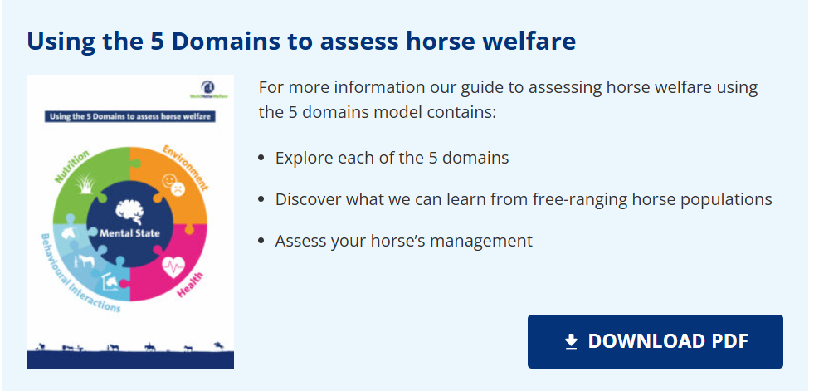
So, what can you do?
Contact Jill at Animal Centric to discuss options for the facilitated WAHY
Early 2026 – Mini-WAHY
Notes:
So, what now? What can you do to start embedding the five domains model into your practice?
For those interested in finding out more about the full, facilitated process, Jill is open to taking enquiries and her details are on the next slide.
We are also working with Jill on a mini-WAHY which will be a free to access, much shorter yard level assessment tool which will consider the 5 domains and welfare criteria at a much broader level and which we hope to launch early next year.
Additionally, for those still getting to grips with the five domains model, we have a free to download pdf guide which talks through key considerations for each domain and poses questions to encourage self-reflection on your practices, which can be found via our website.

Slide 14



Happy to introduce you
Jill Fernandes, PhD
jill@animal-centric.com
www.animal-centric.com
Notes:
Here are Jill’s details for those who may be interested in reaching out to her, alternatively please contact the World Horse Welfare team and we can point you in the right direction.

Slide 15
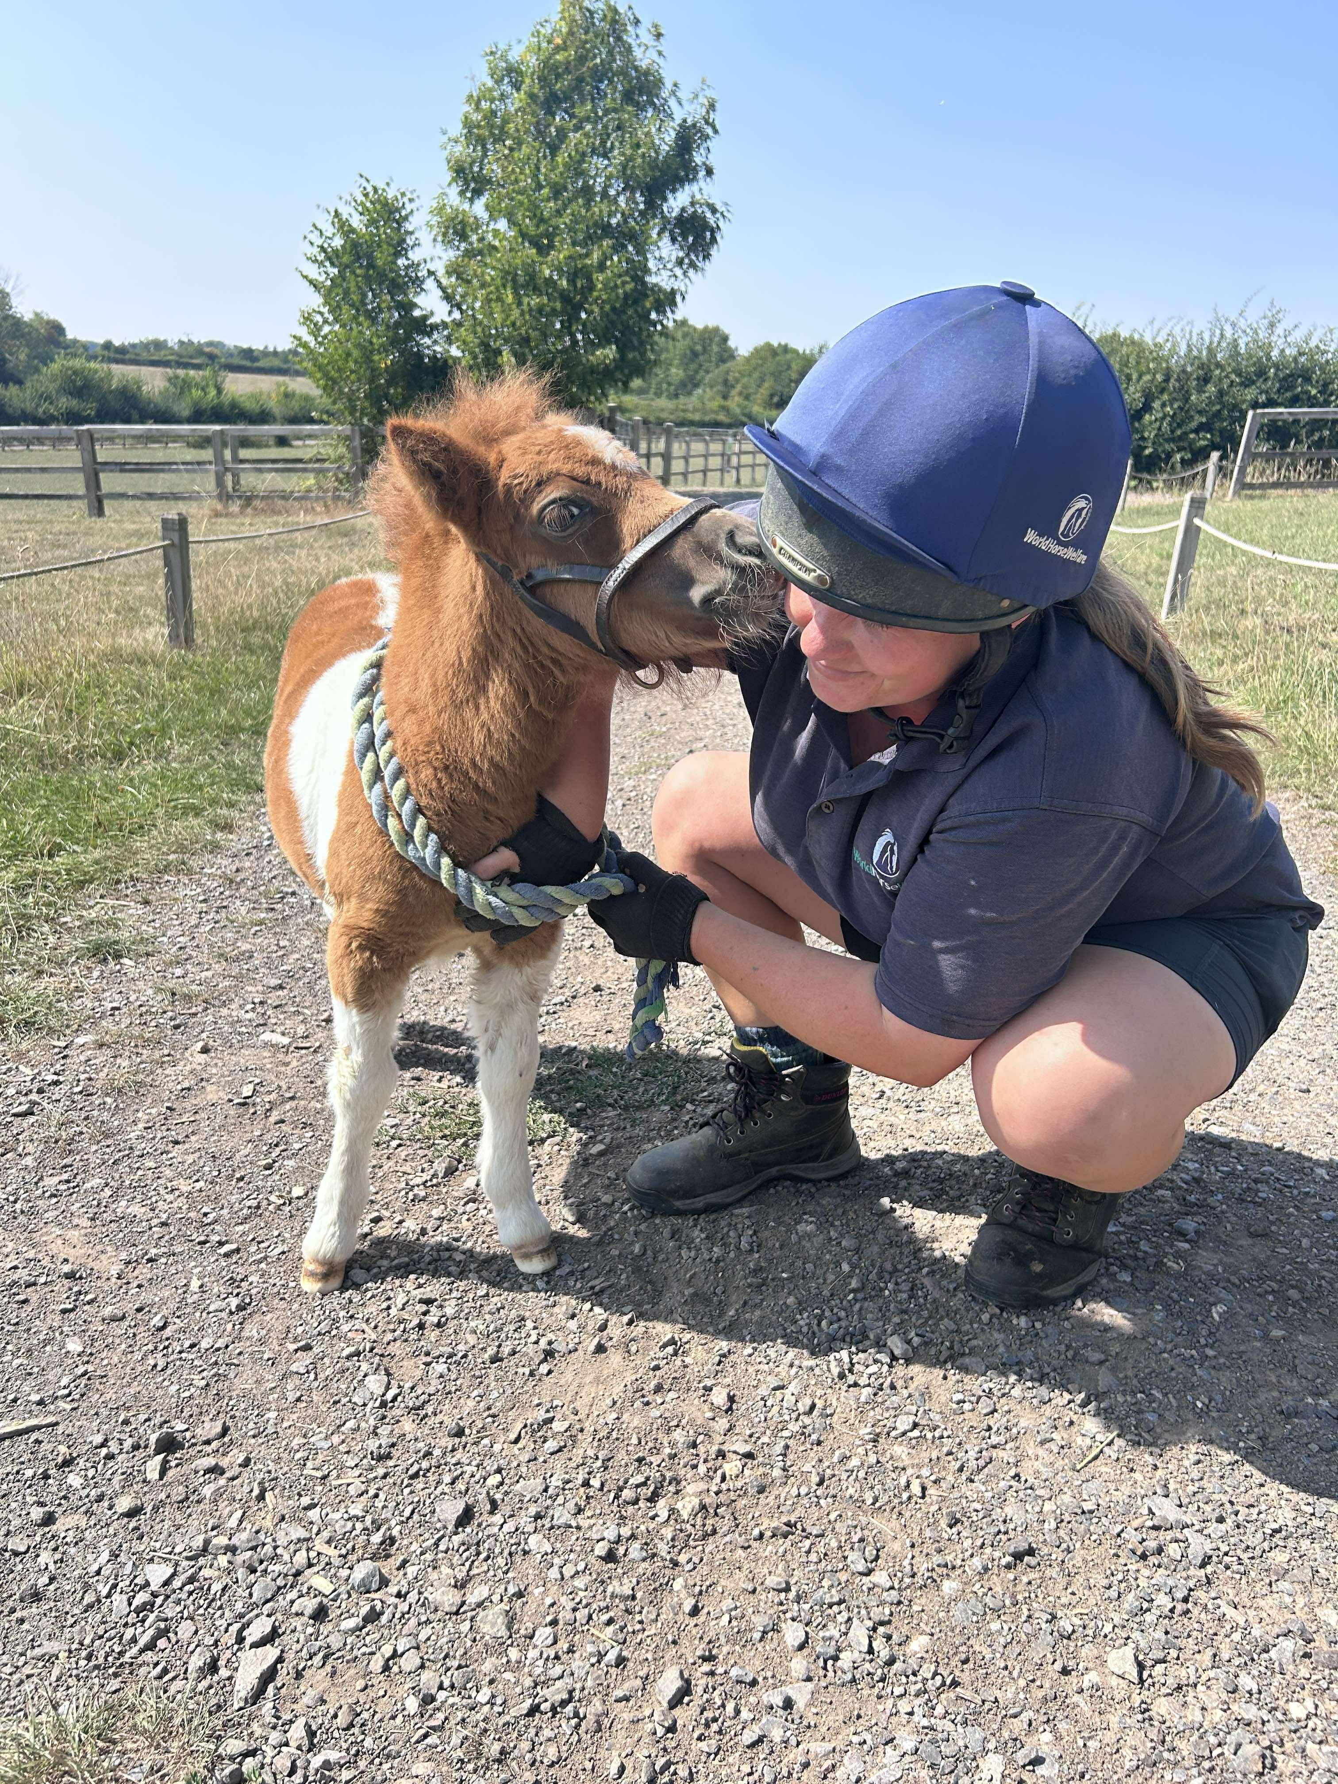
“We firmly believe that lasting change in animal welfare must be driven from the ground up — by animal caregivers”
Reference: Dr Jill Fernandes- Animal Centric
Notes:
I’ll leave you with this quote from Jill.

