Slide 1
ABRS+ Conference 2025
British Equestrian Federation
Jim Eyre
20 October 2025

Slide 2
Context

Slide 3
The Essentials
Safeguarding
Equine Welfare
Equality, Diversity & Inclusion
Environmental Sustainability
Workforce
Business Models
Customer Experience
Social Value

Slide 4
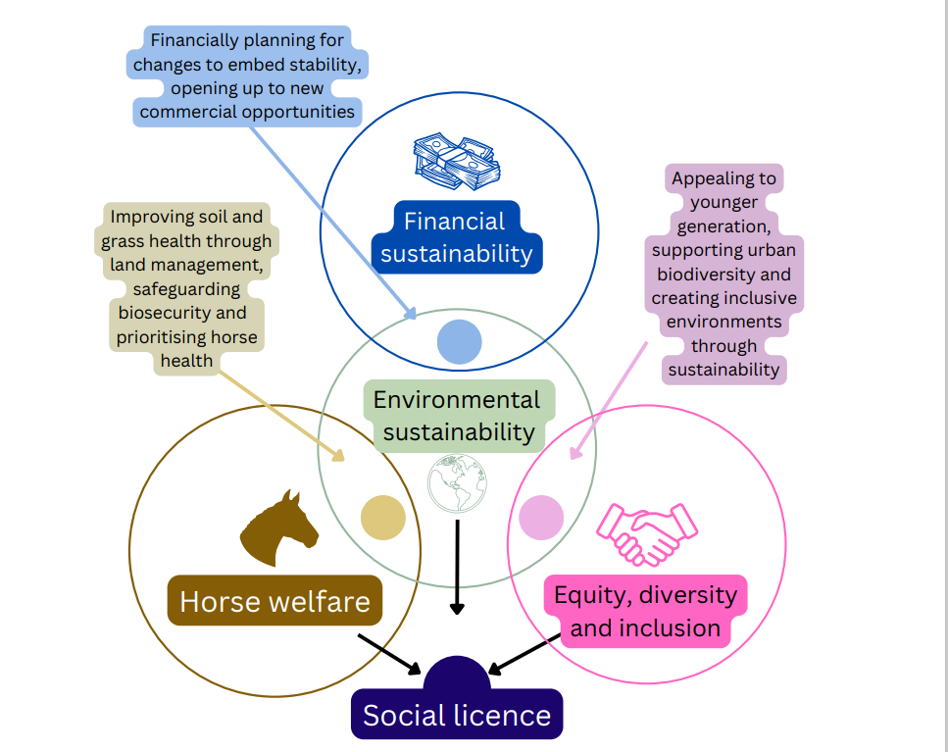

Slide 5
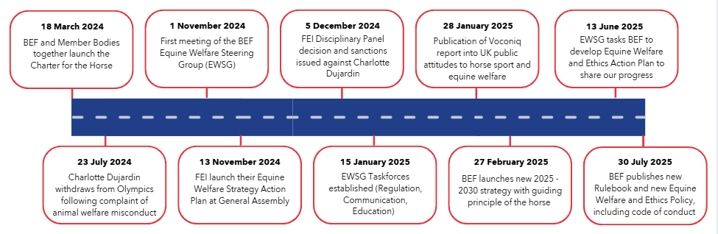

Equine Welfare Steering Group
Timeline of key events:

Slide 6
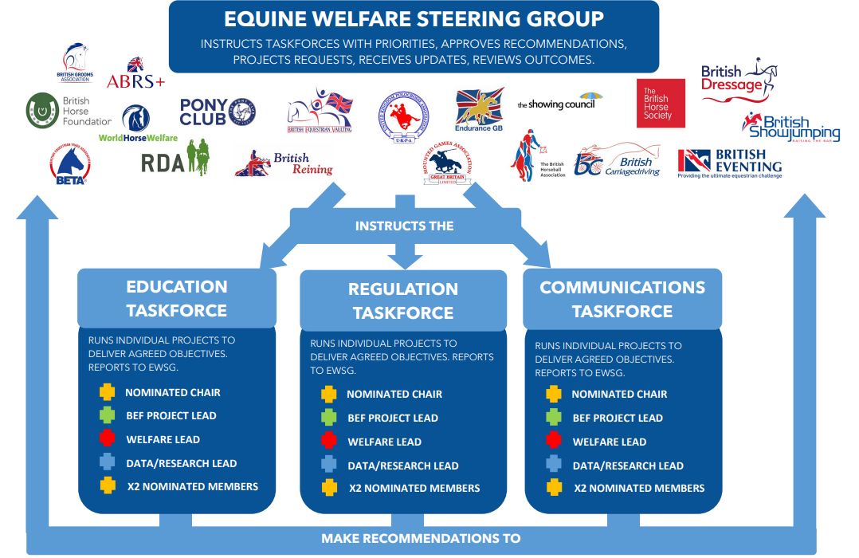

Slide 7
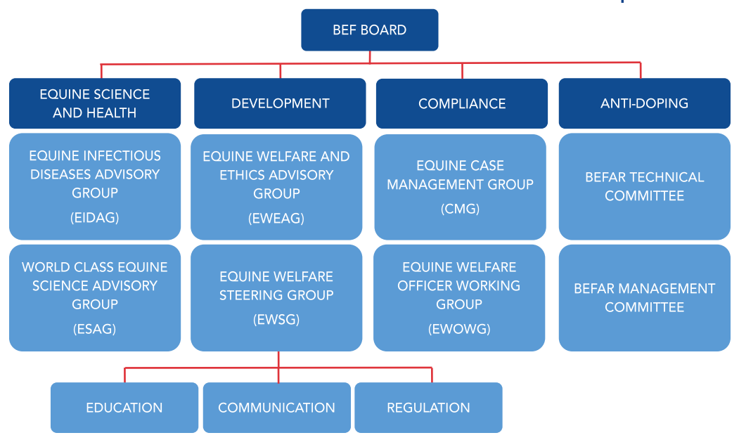
Equine Welfare Steering Group
How the Steering Group relates to other Equine Welfare Committees:

Slide 8
Equine Welfare Steering Group
Priority Projects:
Communication | Education | Regulation
Cross-federation comms groups | Map existing training courses | Central reporting of fatalities
Crisis communications toolkit | Coaching qualification | Mandatory registration of horses
Equine Welfare Action Plan | Training for judges/officials | Expanding anti-doping
Proactive comms campaign based on the Charter for the Horse | Training for others (e.g. riders) | Case Management Procedure
Includes
Each Member Body nominating an EWO
Centralised database for reported concerns
BEF case management group (CMG) with independent experts

Slide 9
ABRS Conference
Coaching Qualification Update
Monday 20th November 2025

Slide 10
Qualification Review
1st 4 Sport Qualification Review – Underway
New direction for qualifications
MB Input into qualification structure
Equine Welfare experts to be consulted
Sport specific technical certificates to be produced

Slide 11
Member Bodies
ABRS (L1, L2, L3)
British Dressage (L2 & L3)
British Showjumping (L2 & L3)
British Horseracing Authority (L1,L2, L3)
British Reining (L2 & L3)
Endurance GB (L2 & L3)
The Pony Club (L1, L2, L3)
British Eventing (L2 & L3)
Riding for the Disabled Association (L1)

Slide 12
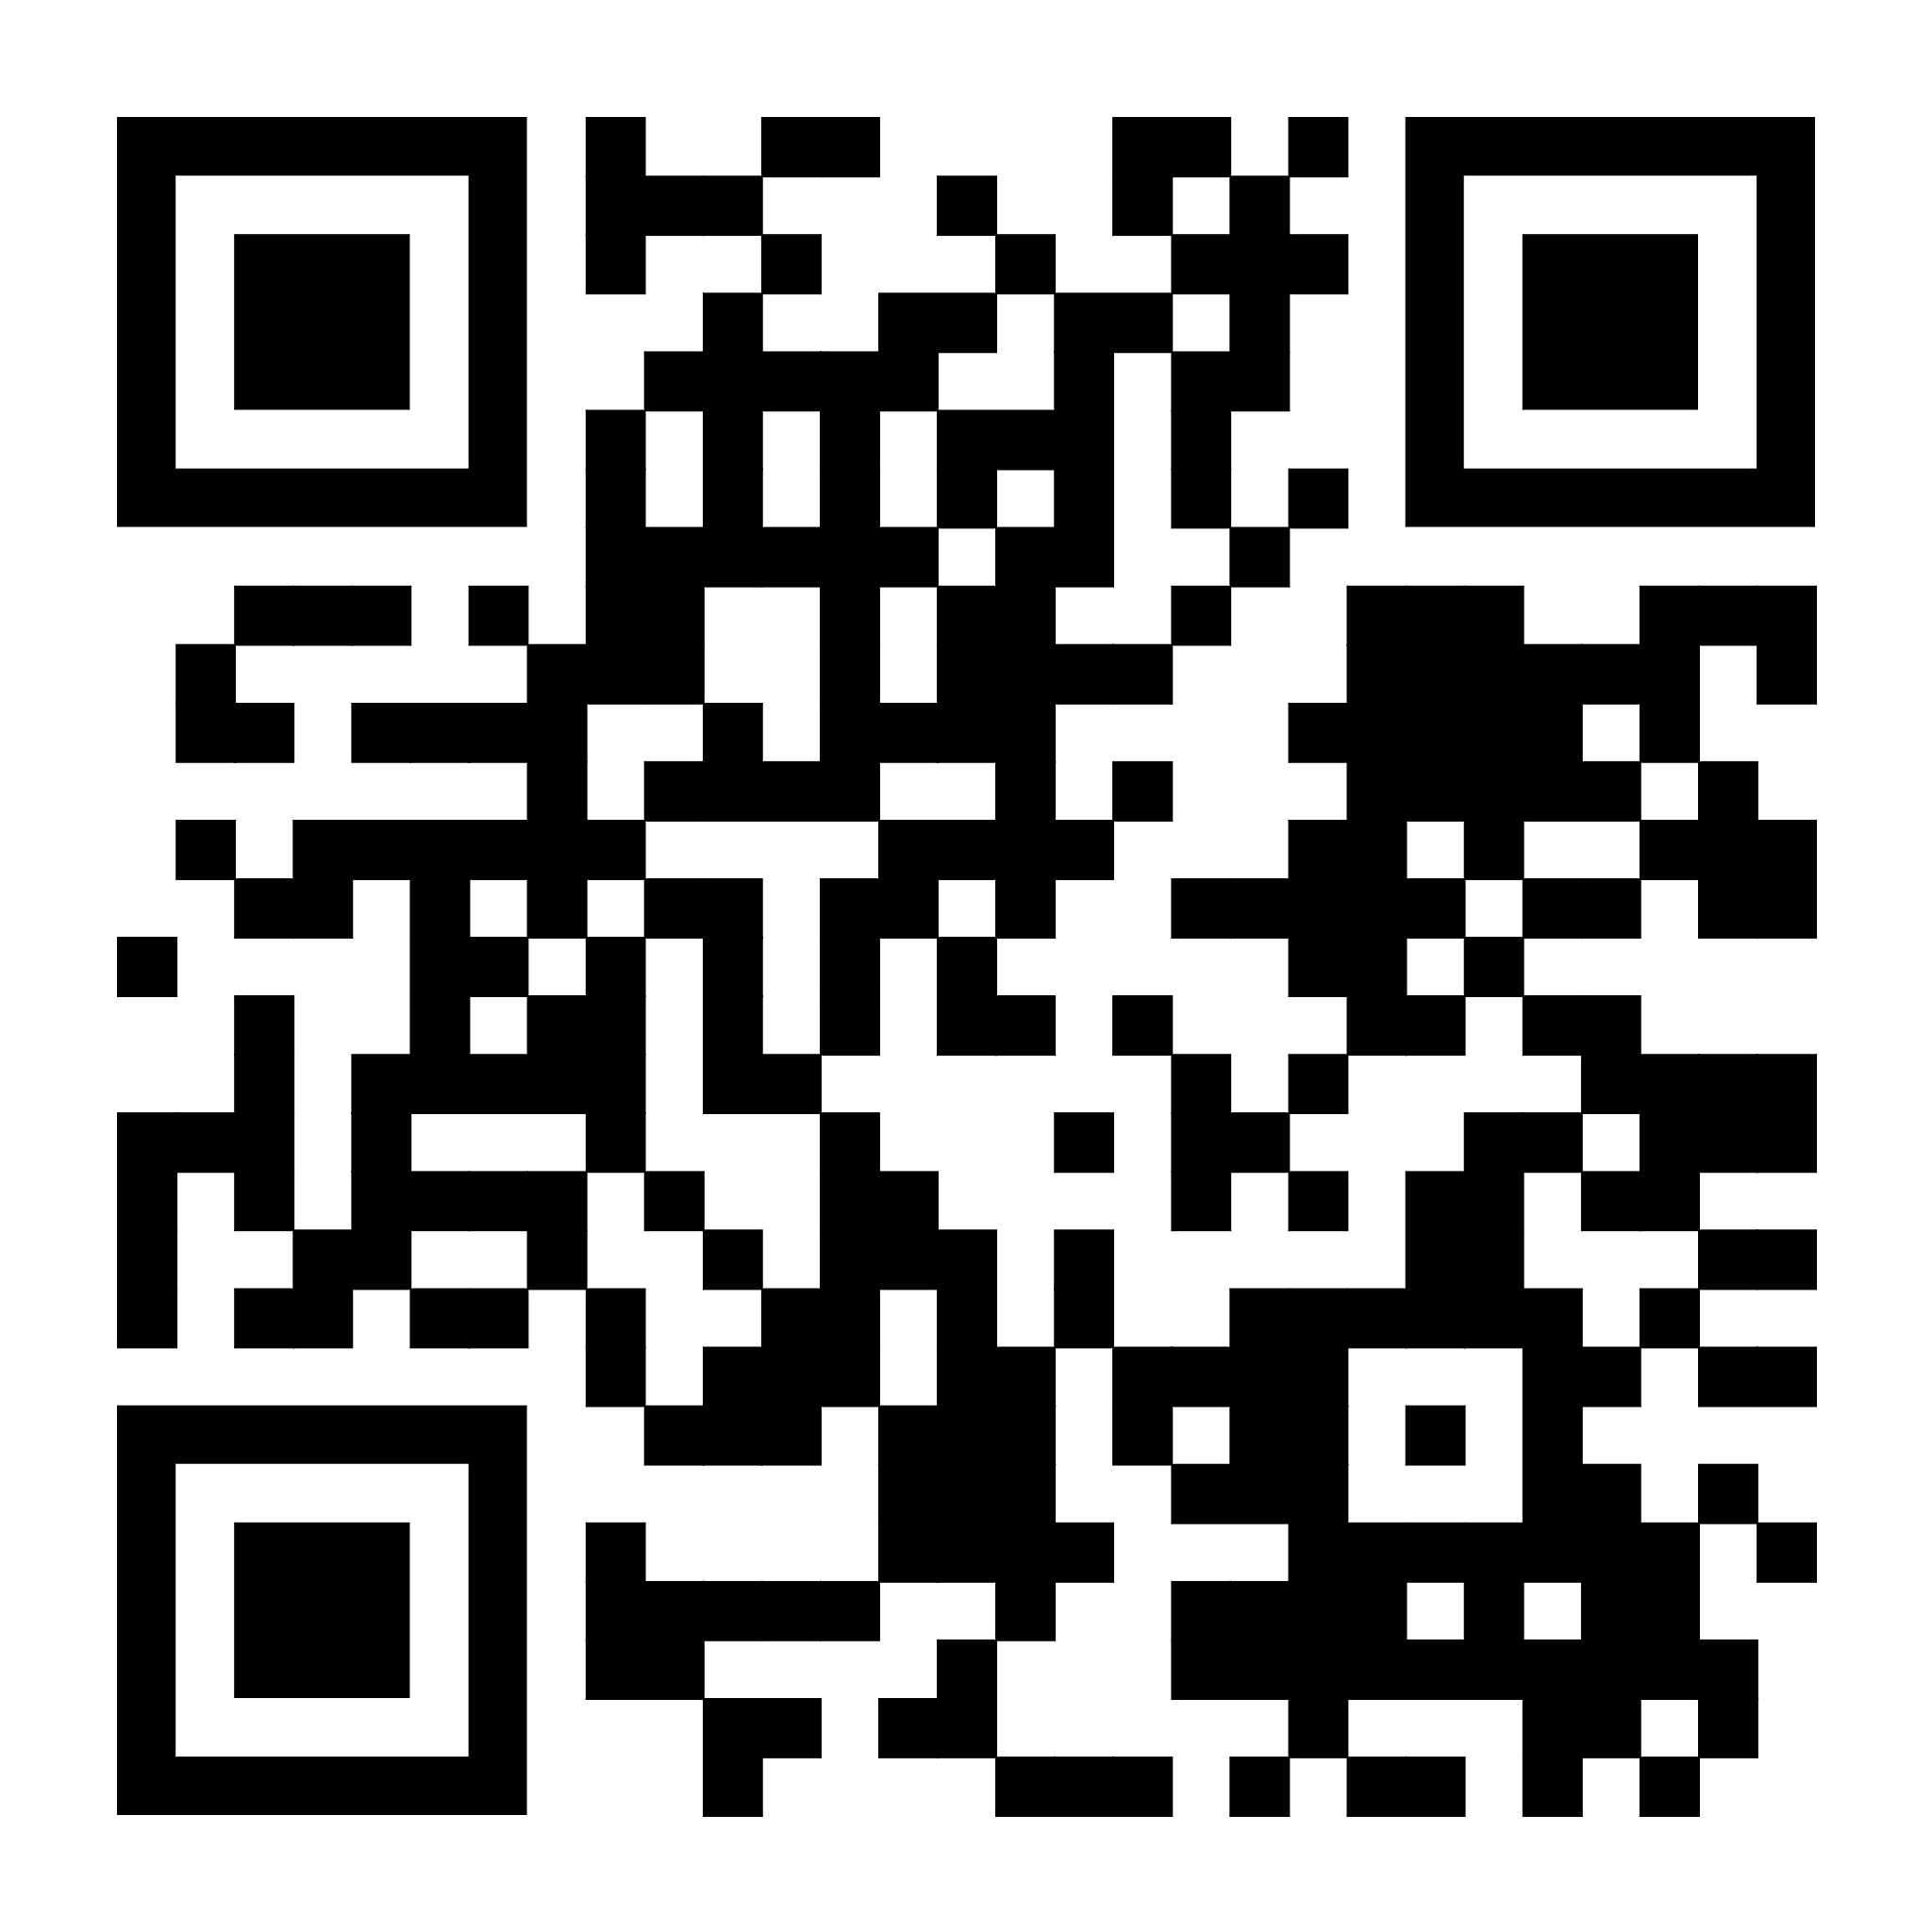
Movement Fund Drop in Sessions
Non-for-profit Riding Centres
3rd / 6th November 12 – 1pm

